Slide 1
eNotaryDoX Video
How to Use Your Own Video Meeting Platform

Slide 2
Alternative Video
Platforms
GoToMeeting- Free 14 day trial
Microsoft Teams- Free version available
Google Meet- Free
Skype- Free

Slide 3
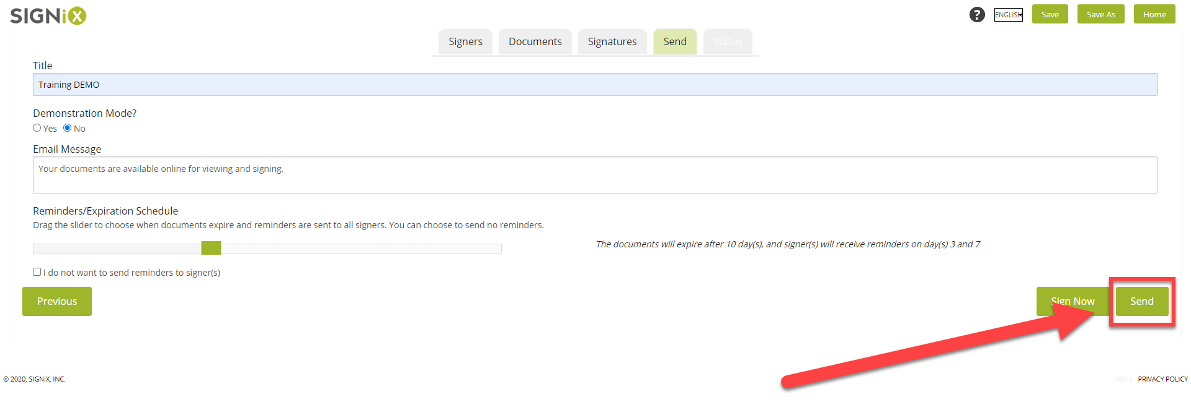
What Changes?
You’ll continue to prepare the documents in the same way. Nothing will change prior to you clicking “Send”

Slide 4
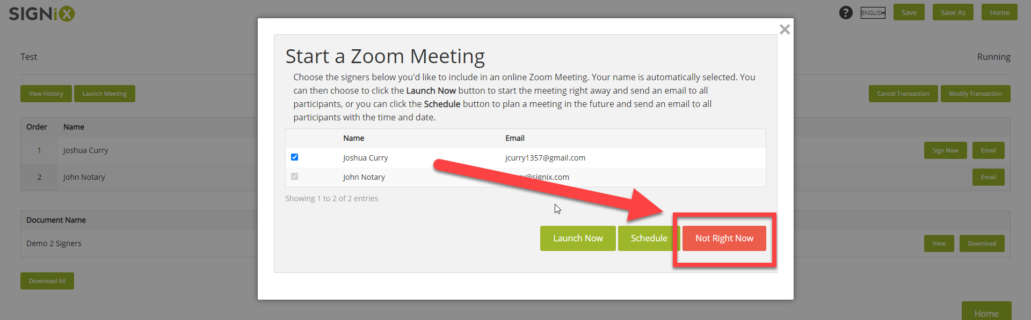
What Changes?
When prompted to start a Zoom meeting, select “Not Right Now”

Slide 5
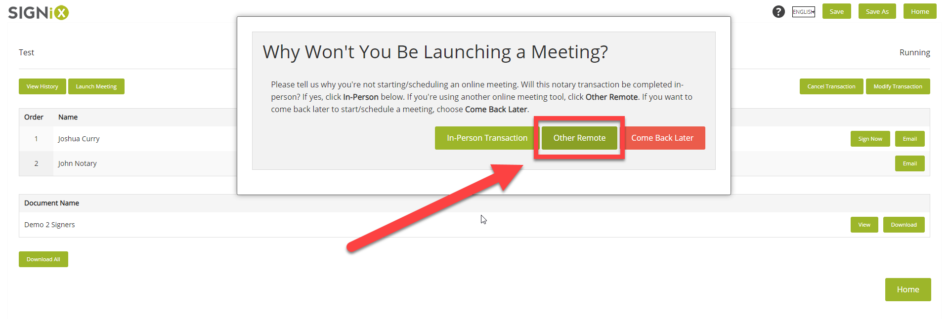
What Changes?
When asked why you won’t be launching a Zoom meeting, select “Other Remote”

Slide 6
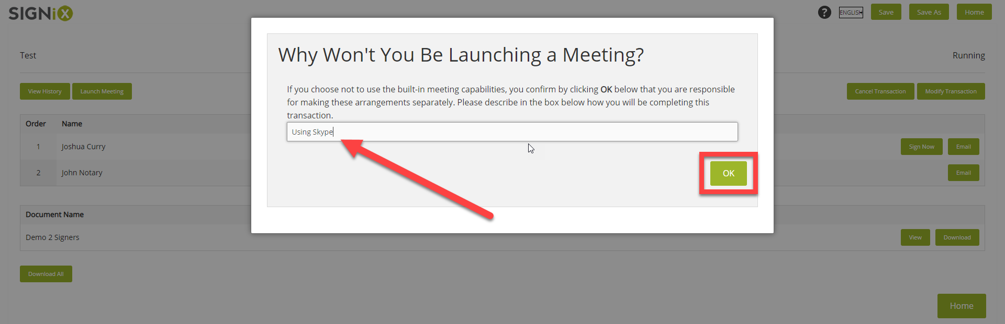
What Changes?
Then enter in the platform you’ve elected to use.

Slide 7
What Changes?
Finally, using whichever platform you have elected to use, schedule a meeting with your signers and ensure it is recorded.
Use webcam video and screen sharing as necessary.
You will save that recording for the state required minimum length of time.

Slide 8
Questions?
customersupport@signix.com

